Slide 1
Welcome
TYIT
Advanced Web Programming

Slide 2


Slide 3
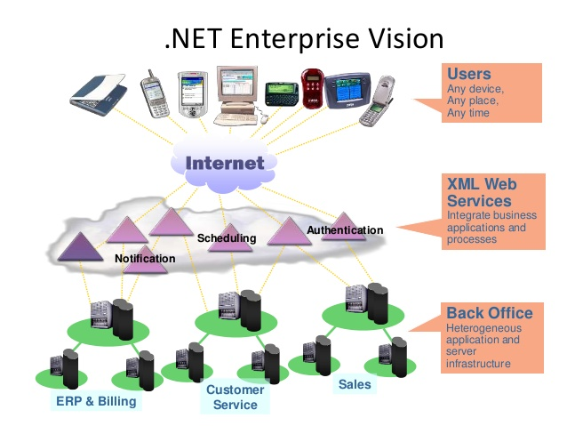

Slide 4
Category of programmers
System Programmers – One who programs directly for a given hardware eg: Device Drivers or extremely low-level o/p services.
Application Programmers: One who Programs application used by people for their requirements- eg: calculator, calendar…etc
.Net is for application Programming.

Slide 5
Platform & Framework
Platform is an environment for developing and executing applications.
Framework is ready to use collection of classes and interfaces used for developing a particular type of application.

Slide 6
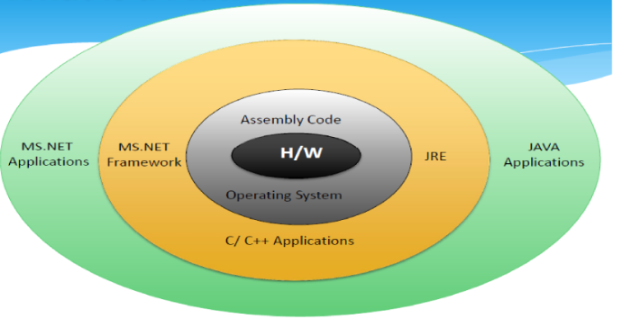

Slide 7
What is .Net?
.NET is a free, cross-platform, open source developer platform for building many different types of applications.
It’s an environment for building and running software applications featuring ease of development of web based services, rich standard runtime services available to components written in variety of programming languages & provides inter language & Inter machine interoperability.
MS.net is a framework built on open internet protocols & Standards with tools and services that meld computing & Communication in new ways.
With .NET, you can use multiple languages, editors, and libraries to build for web, mobile, desktop, games, and IoT.

Slide 8
Languages
You can write .NET apps in C#, F#, or Visual Basic.
C# is a simple, modern, object-oriented, and type-safe programming language.
F# is a cross-platform, open-source, functional programming language for .NET. It also includes object-oriented and imperative programming.
Visual Basic is an approachable language with a simple syntax for building type-safe, object-oriented apps.

Slide 9
Cross Platform
Whether you're working in C#, F#, or Visual Basic, your code will run natively on any compatible OS. Different .NET implementations handle the heavy lifting for you:
.NET Core is a cross-platform .NET implementation for websites, servers, and console apps on Windows, Linux, and macOS.
.NET Framework supports websites, services, desktop apps, and more on Windows.
Xamarin/Mono is a .NET implementation for running apps on all the major mobile operating systems.

Slide 10
Tools
The Visual Studio product family provides a great .NET development experience on Windows, Linux, and macOS.
The Visual Studio Marketplace has thousands of editor extensions from Microsoft and others.

Slide 11
Net framework basic components
MS.Net framework Runtime – Used for both Development & Production of .Net Applications.
MS.Net framework SDK – Mostly used for Development of .Net application.
Visual Studio.Net
IDE & RAD tool for developing .Net applications.
Not needed on production machine.
Common environment for multiple languages like VB.NET,C#...
Can be used for non .net based applications like PHP pages.

Slide 12
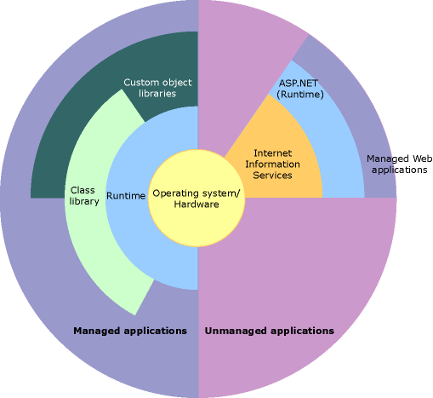
The code, which is developed outside .NET, Framework is known as unmanaged code. Applications that do not run under the control of the CLR are said to be unmanaged
The resource, which is with in your application domain is, managed code. The resources that are within domain are faster. The code, which is dveloped in .NET framework, is known as managed code. This code is directly executed by CLR with help of managed code execution. Any language that is written in .NET Framework is managed code.
Notes:
https://www.c-sharpcorner.com/uploadfile/puranindia/managed-code-and-unmanaged-code-in-net/ -> managed and unmanaged code

Slide 13
Components of .Net Framework
Common Language Runtime (CLR)
Net Framework Class Library.
Windows Application.
Console Application.
Web Application.

Slide 14
Versions of .Net
Version number | CLR version | Release date
1.0 | 1.0 | 2002-02-13
1.1 | 1.1 | 2003-04-24
2.0 | 2.0 | 2005-11-07
3.0 | 2.0 | 2006-11-06
3.5 | 2.0 | 2007-11-19
4.0 | 4 | 2010-04-12
4.5 | 4 | 2012-08-15
4.5.1 | 4 | 2013-10-17
4.5.2 | 4 | 2014-05-05
4.6 | 4 | 2015-07-20
4.6.1 | 4 | 2015-11-17
4.6.2 | 4 | 2016-08-02
4.7 | 4 | 2017-04-05
4.7.1 | 4 | 2017-10-17

Slide 15
.Net Framework
Dot=Document Object Type, Net= Network Enabled Technology.
The Document Object Model (DOM) is a programming API for HTML and XML(Extensible Markup Language) documents. It defines the logical structure of documents and the way a document is accessed and manipulated.
NET (Network Enabled Technology)is the Microsoft Web services strategy to connect information, people, systems, and devices through software, Integrated across the Microsoft platform.
.NET technology provides the ability to quickly build, deploy, manage, and use connected, security-enhanced solutions with Web services.

Slide 16
The .NET Framework is cluster of several technologies, The .NET languages which include Visual Basic, C#, F#, and C++, although third-party developers have created hundreds more.
The Common Language Runtime (CLR): This is the engine that executes all .NET programs and provides automatic services for the applications, such as security checking, memory management, and optimization.
ASP.NET also refers to the whole topic of .NET web applications, which includes .NET languages and many fundamental pieces of the class library that aren’t web-specific such as secure authentication and data storage.
(ASP stands for Active Server Pages. ASP is a development framework for building web pages.)
The .NET Framework class library: The class library collects thousands of pieces of prebuilt functionality that you can include to your applications.

Slide 17
These features are sometimes organized into technology sets, such as ADO.NET-ActiveX Data Object (the technology for creating database applications) and Windows Presentation Foundation (WPF, the technology for creating desktop user interfaces).
Visual Studio: This optional development tool contains a rich set of productivity and debugging features. Visual Studio includes the complete .NET Framework, so you won’t need to download it separately.

Slide 18
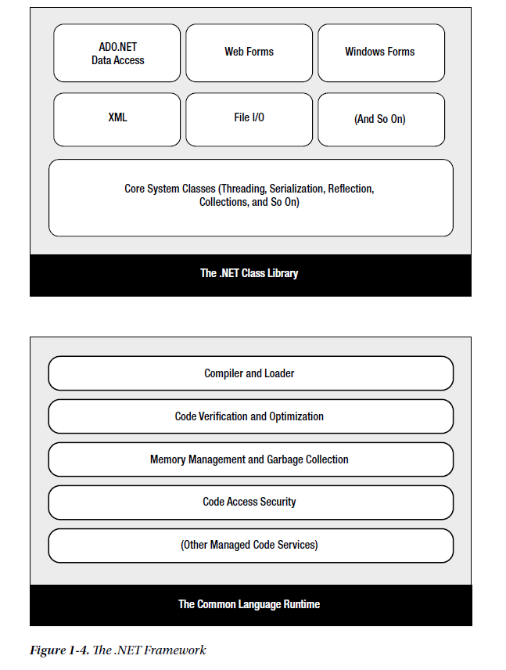

Slide 19
C#, VB, and the .NET Languages
Visual Basic is a component of Visual Studio.
Visual Studio normally refers to the entire suite of development applications (Visual Basic, Visual C#, Visual C++, etc.).
Visual Studio is the integrated development environment (IDE) used to create programs in Visual Basic or the other 'Visual' named languages.
The .NET version of VB is similar in syntax to older flavors of VB including “classic” VB 6 and the Visual Basic for Applications (VBA) language often used to write macros in Microsoft Office programs such as Word and Excel.
Notes:
https://www.c-sharpcorner.com/blogs/what-are-cts-and-cls-in-net

Slide 20
Conversion of classic VB into the .NET flavor of Visual Basic is not possible, just as you cannot convert C++ into C#.
We use C#, Microsoft’s .NET language of preference.
C# resembles Java, JavaScript, and C++ in syntax, so programmers who have coded in one of these languages will quickly feel at home.
VB and C# are quite similar. Though the syntax is different, both VB and C# use the .NET class library and are supported by the CLR.
In fact, almost any block of C# code can be translated, line by line, into an equivalent block of VB code (and vice versa). There are even software tools that translate C# and VB code automatically.

Slide 21
Intermediate Language (IL)
All the .NET languages are compiled into another lower-level language before the code is executed. This lower level language is the Common Intermediate Language (CIL, or just IL).
The CLR is the engine of .NET which uses only IL code due to similarities of multiple languages.
The VB and C# languages provide essentially the same features and performance, due to the compatibility a web page written with C# can use a VB component in the same way it uses a C# component, and vice versa.
The .NET Framework formalizes this compatibility with something called the Common Language Specification (CLS).

Slide 22
The CLS is a contract that, guarantees that a component written in one .NET language can be used in all the others.
One part of the CLS is the Common type system (CTS) , which defines the rules for data types such as strings, numbers, and arrays that are shared in all .NET languages.
The CLS also defines object-oriented ingredients such as classes, methods, events, and many more.
.NET language contains IL code. This is the file you deploy to other computers.
In the case of a web application, you deploy your compiled code to a live web server.

Slide 23
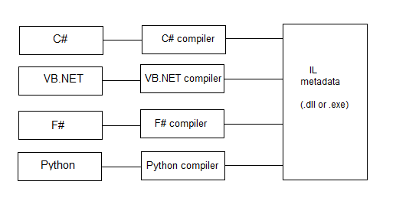
Fig: Basic Language Compilation

Slide 24
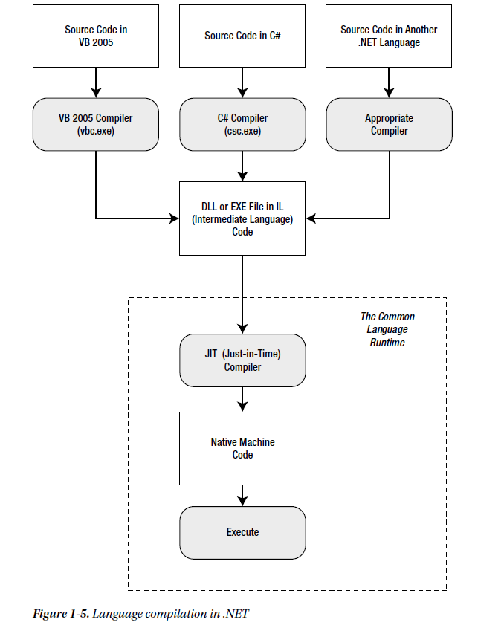
Notes:
Figure 1-5 shows how the .NET languages are compiled to IL. Every EXE or DLL file that you build with a
.NET language contains IL code. This is the file you deploy to other computers. In the case of a web application,
you deploy your compiled code to a live web server.

Slide 25
The CLR runs only IL code, without any idea of which .NET language you originally used.
However, that the CLR performs another compilation step—it takes the IL code and transforms it to native machine language code that’s appropriate for the current platform. This step occurs when the application is launched, just before the code is executed.
Also, the CLR execute code, along with providing a whole set of related services such as code verification, optimization, and object management.
The implications of the CLR are wide-ranging:
Deep language integration: VB and C#, like all .NET languages, compile to IL. This is far more than mere language compatibility; it’s language integration.
Side-by-side execution: The CLR also has the ability to load more than one version of a component at a time.
Fewer errors: Whole categories of errors are impossible with the CLR. For example, the CLR prevents many memory mistakes that are possible with lower-level languages such as C++.

Slide 26
The CLR has some potential drawbacks:
Performance: A typical ASP.NET application is extremely fast, because ASP.NET code is compiled to machine code before it’s executed. However, processor-crunching algorithms still can’t match the blinding speed of well-written C++ code, because the CLR imposes some additional overhead.
Code transparency: IL is much easier to disassemble, meaning that if you distribute a compiled application or component, other programmers may have an easier time determining how your code works.

Slide 27
To be continued….

